Slide 1

WOLKITE UNIVERSITY
College of Computing & Informatics
Department of Computer Science
Regular Program
Design and Analysis of Algorithms(CoSc3092)
Chapter One
Introduction and Elementary Data Structures

Slide 2
Outline
Introduction to Algorithm analysis
Asymptotic Notations
Analysis of Algorithm
Review of elementary Data Structures
Heaps
Hashing
Set Representation
UNION, FIND Operation

Slide 3
Introduction
To apply algorithm first of all there should be a problem that needs solution
– Is there any problem for which we can’t design algorithm?
– Program = Algorithm + Data Structure

Slide 4
What is an algorithm?
An algorithm is a sequence of unambiguous instructions for solving a problem, i.e., for obtaining a required output for any legitimate input in a finite amount of time
From the above definition, algorithm has the following five properties: Sequence, Unambiguous, Input, Output, Finite

Slide 5
Algorithms
All algorithms must satisfy the following properties
Input. Zero more quantities are externally supplied.
Output. At least one quantity is produced.
Definiteness. Each instruction is clear and unambiguous.
Finiteness. the algorithm terminates after a finite number of steps.
Effectiveness. It is not enough that each operation be definite as in 3) it also must be feasible.

Slide 6
Example: Searching
Problem of searching an ordered list.
Given a list L of n elements that are sorted into a definite order (e.g., numeric, alphabetical),
And given a particular element x,
Determine whether x appears in the list, and if so, return its index (position) in the list.

Slide 7
Search alg. #1: Linear Search
//Searches for a given value in a given array by sequential search
//Input: An array L[0 .. n -1] and a search key x
//Output: The index of the first element of L that //matches x or -1 if there are no matching elements
i:=0
while i <n and L[i] ≠ x do
i:=i+1
If i < n return i
else return -1

Slide 8
Search alg. #2: Binary Search
Basic idea: On each step, look at the middle element of the remaining list to eliminate half of it, and quickly zero in on the desired element.
<x
<x
<x
>x

Slide 9
Search alg. #2: Binary Search
procedure binary search (x:integer, a₁, a₂, …, a_{n}: distinct integers) i := 1 {left endpoint of search interval} j := n {right endpoint of search interval} while i<j begin {while interval has >1 item} m := ⎣(i+j)/2⎦ {midpoint} if x>a_{m} then i := m+1 else j := m end if x = a_{i} then location := i else location := 0 return location

Slide 10
Is Binary Search more efficient?
Number of computations per iteration:
Binary search does more computations than Linear Search per iteration.
Overall:
If the number of components is small (say, less than 20), then Linear Search is faster.
If the number of components is large, then Binary Search is faster.

Slide 11
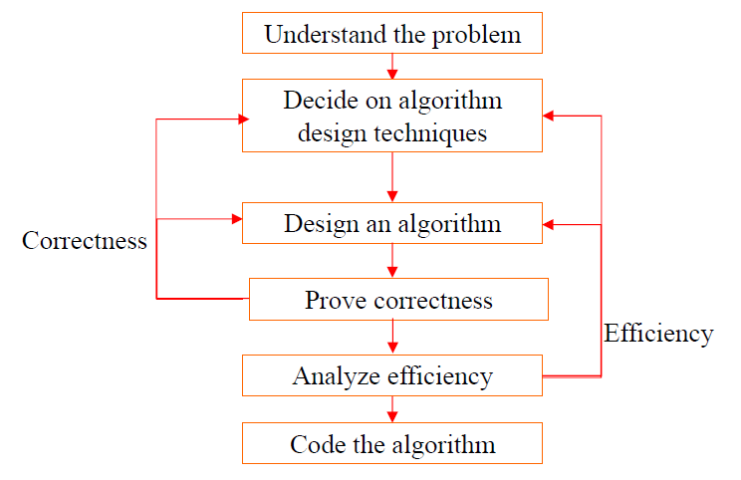
Algorithm Design & Analysis Process

Slide 12
Analysis of Algorithm
As we may have noted, there are often multiple algorithms one can use to solve the same problem.
– In searching, one can use linear search, binary search, …..
–For sorting a sequence of list, we may consider bubble sort, selection sort, quick sort, merge sort, heap sort,…
–We can come up with our own variants.
Why all these algorithms? Do we need them?
How do we choose which algorithm is the best?
–The fastest/most efficient algorithm.
–The one that uses the fewest resources.
–The clearest.
–The shortest, ...

Slide 13
Analysis of Algorithm…
The analysis of algorithms is the process of finding the computational complexity of algorithms
—the amount of time, storage, or other resources needed to execute them.
–An algorithm that solves a problem but requires a year and GBs of main memory is hardly of any use.
•The objective of algorithm analysis is
–To measure resources (e.g., time, space) requirements of an algorithm so as to determine how quickly (with less memory) an algorithm executes in practice
An algorithm should make efficient use of computer resources
–Most frequently, we look at efficiency, i.e.
how long does the algorithm take to run
What is the best way to represent the running time of an algorithm?

Slide 14
Efficiency
An algorithm must solve a problem with the least amount of computational resources such as time and space.
–An algorithm should run as fast as possible using as little memory as possible
•Two types of algorithmic efficiency evaluation
–Time efficiency-indicates how fast the algorithm runs
–Space efficiency-indicates how much memory the algorithm needs
What to analyze?
–To keep things simple, we will concentrate on the running time of algorithms and will not look at the space (the amount of memory) needed or required.
–So, efficiency considerations of algorithm usually focus on the amount of time elapsed (called running time of an algorithm) when processing data.

Slide 15
Correct Algorithm
A correct algorithm solves the given computational problem
–If the algorithm is not doing what it is supposed to do, it is worthless
An algorithm is said to be correct if, for everyinput instance, it halts with the correct output
An incorrect algorithm
–might not halt at all on some input instances, or
–might halt with a wrong answer.
In order to show that an algorithm is incorrect, we need just one instance of its input for which the algorithm fails.

Slide 16
Why need algorithm analysis ?
Suppose computers are infinitely fast and computer memory was free. Would you have any reason to study algorithm?
–Yes, because we want to demonstrate that the algorithm is correct;
it terminates with the intended solution for all inputs given.
However, the reality shows that :
– Computers may be fast, but they are not infinitely fast
– Memory may be cheap, but it is not free
– Computing time and resources are therefore a bounded resources

Slide 17
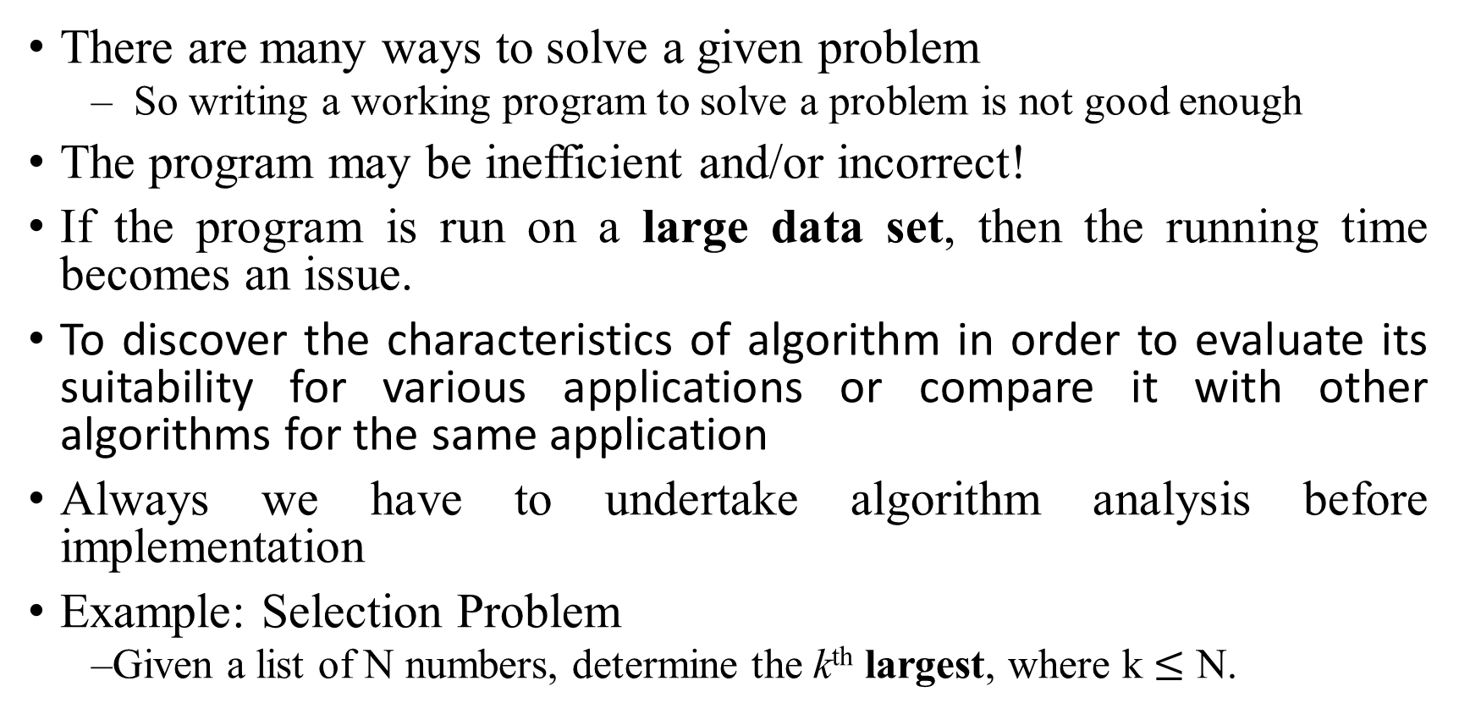
Why need algorithm analysis ?...
There are many ways to solve a given problem
– So writing a working program to solve a problem is not good enough
The program may be inefficient and/or incorrect!
If the program is run on a large data set, then the running time becomes an issue.
To discover the characteristics of algorithm in order to evaluate its suitability for various applications or compare it with other algorithms for the same application
Always we have to undertake algorithm analysis before implementation
Example: Selection Problem
–Given a list of N numbers, determine the k^{th} largest, where k $≤$ N.

Slide 18
Example: Selection Problem
Algorithm 1:
(1) Read N numbers into an array
(2) Sort the array in decreasing order by some simple algorithm
(3) Return the element in k^{th} position

Slide 19
Example: Selection Problem…
Algorithm 2:
(1) Read the first k elements into an array and sort them in decreasing order
(2) Each remaining element is read one by one
–If smaller than the k^{th} element, then it is ignored
–Otherwise, it is placed in its correct spot in the array, bumping one element out of the array.
(3) The element in the k^{th} position is returned as the answer.

Slide 20
Areas of studies of Algorithms
How to devise algorithms-The act of creating an algorithm is an art which may never be fully automated. A major goal of this course is to study various design techniques which have proven to be useful in that they have often yielded good algorithms. By mastering these design strategies, it will become easier for you to devise new and useful algorithms.
How to validate algorithms-Once an algorithm is devised it is necessary to show that it computes the correct answer for all possible legal inputs. We refer to this process as algorithm validation.

Slide 21
Areas of studies of Algorithms
How to analyze algorithms-This field of study is called analysis of algorithms. Analysis of algorithms refers to the process of determining how much computing time and storage an algorithm will require. This area is a challenging one which sometimes requires great mathematical skill. One important result of this study is that it allows one to make quantitative judgments about the value of one algorithm over another.
How to express algorithms-The clear and concise expression of algorithms in a programming language.

Slide 22
Areas of studies of Algorithms
How to test a program-Testing a program really consists of two phases: debugging and profiling.
Debugging is the process of executing programs on sample data sets to determine if faulty results occur and, if so, to correct them.
Profiling is the process of executing a correct program on data sets and measuring the time and space it takes to compute the results.

Slide 23
Types of Analysis
The efficiencies of some algorithms may differ significantly for inputs of the same size. In this course we will perform the following types of analysis:
Best Case running time
Average Case running time
Worst Case running time
Which one is good? Discuss.
Take as an Example the Linear Search

Slide 24
best-case Running time…
The best-case running time complexity of the algorithm is the function defined by the minimum number of steps taken on any instance of size N.
The term best-case running time is used in computer science to describe an algorithm's behavior under optimal conditions.
Best-case running time: The shortest running time for any input of size n. The algorithm will never be faster than this.
For example,-the best case for a simple linear search on a list occurs when the desired element is the first element of the list.
The best case for a sorting algorithm would be data that's already sorted.
Development and choice of algorithms is rarely based on best-case performance

Slide 25
Average-case Running time…
the average-case running time complexity of the algorithm is the function defined by an average number of steps taken on any instance of size N.
We take all possible inputs and calculate computing time for all of the inputs. Sum all the calculated values and divide the sum by total number of inputs.
We must know (or predict) distribution of cases.
For the linear search problem, let us assume that all cases are uniformly distributed (including the case of x not being present in array).
So we sum all the cases and divide the sum by (n+1). Following is the value of average case time complexity.

Slide 26
worst-case Running time…
The worst-case runtime complexity of the algorithm is the function defined by the maximum number of steps taken on any instance of size N.
We shall usually concentrate on finding only the worst-case running time, that is, the longest running time for any input of size N.
The worst-case running time of an algorithm gives us an upper bound on the running time for any input.
Knowing it provides a guarantee that the algorithm will never take any longer.
When not otherwise specified, the function describing the performance of an algorithm is usually an upper bound, determined from the worst case inputs to the algorithm
For example, the worst case for a sorting algorithm might be data that's sorted in reverse order
The worst case for a simple linear search on a list occurs when the desired element is the last element of the list.

Slide 27
Performance Analysis
Space Complexity- S(P): The space complexity of a program is the amount of memory it needs to run to completion.
The space requirement S(P) of any program P is written as S(P) = c +Sp where c is a constant(fixed part) and Sp(variable part/Instance characteristics)
A fixed part that is independent of the characteristics of the inputs and outputs. typically includes the space for simple variables and space for constants, etc.
A variable part that consists of the space needed by component variables whose size is dependent on the particular problem instance being solved

Slide 28
Performance Analysis
2. Time Complexity-T(P): The time, T(P), taken by a program P is the sum of the compile time and the run (or execution) time.
The compile time does not depend on the instance characteristics. We focus on the run time of a program, denoted by T(P) (instance characteristics).

Slide 29
Computing running time
Algorithm 1 Algorithm 2
Cost Cost
arr[0] = 0; c1 for(i=0; i<N; i++) c2
arr[1] = 0; c1 arr[i] = 0; c1
arr[2] = 0; c1
...
arr[N-1] = 0; c1
----------- -------------
c1+c1+...+c1 = c1 x N (N+1) x c2 + N x c1 =
(c2 + c1) x N + c2
O(n)

Slide 30
Computing running time (cont.)
Cost
sum = 0; c1
for(i=0; i<N; i++) c2
for(j=0; j<N; j++) c2
sum += arr[i][j]; c3 ------------
c1 + c2 x (N+1) + c2 x N x (N+1) + c3 x N x N
O(n²)

Slide 31
Examples (cont.’d)
if (i<j)
for ( i=0; i<N; i++ )
X = X+i;
else
X=0;
Max ( O(N), O(1) ) = O (N)
O(N)
O(1)

Slide 32
Example cont.’d
Algorithm swap(a, b)
{
temp= a;…………………1
a=b; ……………………..1
b= temp; …………………1
}
Every simple statement is counted as 1 unit of time hence f(n)= 3, O(1)
Space complexity is calculated for a, b and temp; hence S(n) =3, O(1)

Slide 33
computational complexity of algorithm that sum up the elements of an array
Algorithm sum(A, n)
{ s=0;………………… 1
for(i=0;i<n;i++)………… n+1
{ s=s+A[i]; } ……………… n
return s; …………………… 1
}}
The time complexity is f(n)= 2n+3→ O(n)
The space complexity is calculated as 1unit for n,s,i and n for A, then S(n)= n+3 → O(n)

Slide 34
computational complexity of algorithm that sum up the elements of two a matrix
Algorithm(A, B, n)
{
for(i=0; i<n; i++){………………………………..n+1
for(j=0; j<n; j++)…………………………………..n*(n+1)
{
C[i, j]= A[i, j]+ B[i, j];………….. n*n
}}
Time complexity is f(n)=2n²+2n+1→O(n²)
The space complexity is A=n², B=n², C=n² , n=1, i=1, j=1
hence S(n)=3n² +3 →O(n²)

Slide 35
computational complexity of algorithm that multiply the elements of the matrix
Algorithm(A, B, n)
{for(i=0; i<n; i++){………………………..n+1
for(j=0;j<n; j++)………………………… n*(n+1)
{ C[i,j]= 0;………….. n*n
for(k=0;k<n; k++)………………………………… n*n*(n+1)
{C[i,j]= C[i,j]+ A[i,k]* C[k,j]………….. n*n*n
} }
Time complexity is f(n)=2n³ +3n²+2n+1→O(n³)
The space complexity for matrix is A=n², B=n², C=n² , n=1, i=1, j=1, k=1
Hence S(f)=3n² +4 →O(n²)

Slide 36
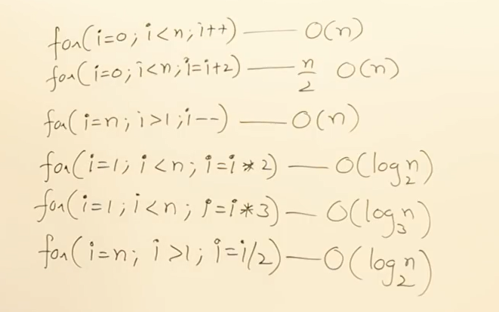
Time complexity of for loop

Slide 37
Time complexity of while loop
i=0……………….. 1
While(i<n)…….n+1
{
Statement;…………..n
i++;………………………………n
}
T(n)=3n+2➔O(n)
a=1
While(a<b)
{
Statement;
a=a*2;
}
T(n)=log₂b➔O(logn)

Slide 38
Time complexity of if…else
Algorithm test(n)
{
if(n<7) {
statement;
}
else
{for(i=0;i,<n; i++){statement;}
}}
If the condition is true f(n)=O(1) else f(n)= O(n)

Slide 39
How do we analyze algorithms?
We need to define a number of objective measures.
(1) Compare execution times?
Not good: times are specific to a particular computer !!
(2) Count the number of statements executed?
Not good: number of statements vary with the programming language as well as the style of the individual programmer.

Slide 40
Example (number of statements)
Algorithm 1 Algorithm 2
arr[0] = 0; for(i=0; i<N; i++)
arr[1] = 0; arr[i] = 0;
arr[2] = 0;
arr[3] = 0;
...
arr[N-1] = 0;

Slide 41
How do we analyze algorithms?
(3) Step count
Iterative function to sum a list of numbers
steps/execution

Slide 42
Step count
Determining step counts help us to compare the time complexities of two programs and to predict the growth in run time as the instance characteristics change.
But determining exact step counts could be very difficult. Since the notion of a step count is itself inexact, it may be worth the effort to compute the exact step counts.

Slide 43
How do we analyze algorithms?...
(4) Express running time as a function of the input size n (i.e., f(n)). [Order of growth] [Asymptotic Analysis]
To compare two algorithms with running times f(n) and g(n), we need a rough measure of how fast a function grows. [Order of growth]
Such an analysis is independent of machine time, programming style, etc.
Running time analysis is determining how running time increases as the size of the problem increases
We usually consider one algorithm to be more efficient than another if its worst case running time has a smaller order of growth.

Slide 44
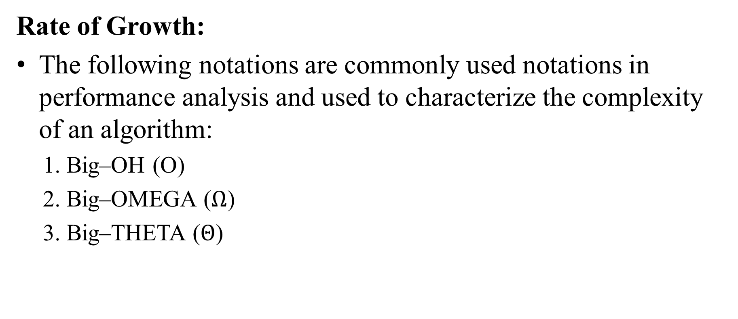
Asymptotic Analysis
Rate of Growth:
The following notations are commonly used notations in performance analysis and used to characterize the complexity of an algorithm:
1. Big–OH (O)
2. Big–OMEGA ($Ω$)
3. Big–THETA ($Θ$)

Slide 45
Big-O Notation (Upper Bound)
f(n) = O(g(n)), (pronounced order of or big oh), says that the growth rate of f(n) is less than or equal (<=) that of g(n).
We can replace f(n) by g(n) and know we aren't “off too far.”
We say f(n) is "in the order of g(n)" or, simply, f(n) ∈ O(g(n)).
Usually, g(n) is a simple function, like, n, n², nlog(n), n³, 2^{n}, etc., that's easy to understand and use.
Useful when f(n) is not known precisely, is complicated to compute, and/or difficult to use.
Basically, it tells you how fast a function grows or declines as the input grows

Slide 47
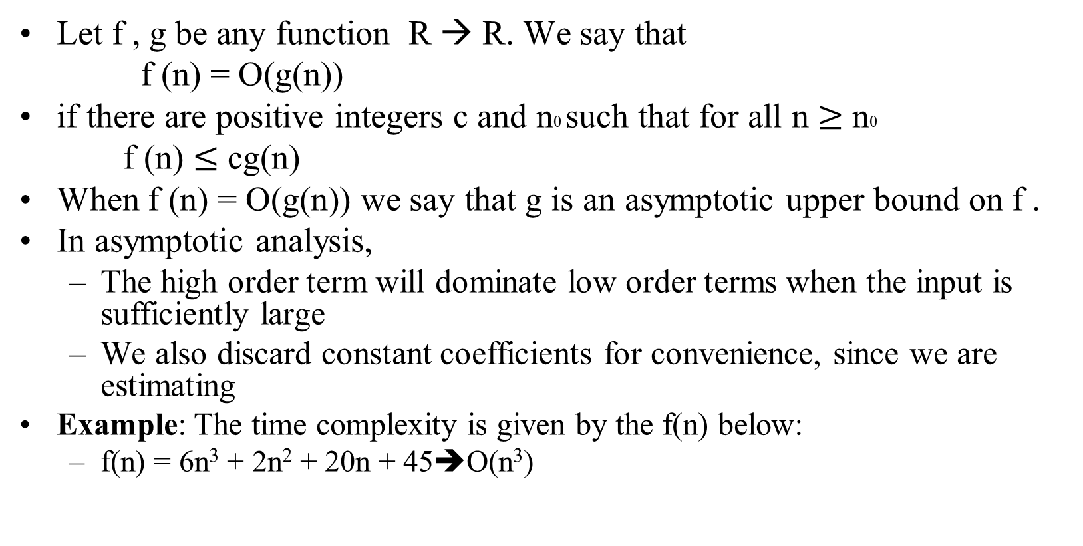
Big-O Notation…
Let f , g be any function R → R. We say that
f (n) = O(g(n))
if there are positive integers c and n0 such that for all n $≥$ n0
f (n) $≤$ cg(n)
When f (n) = O(g(n)) we say that g is an asymptotic upper bound on f .
In asymptotic analysis,
The high order term will dominate low order terms when the input is sufficiently large
We also discard constant coefficients for convenience, since we are estimating
Example: The time complexity is given by the f(n) below:
f(n) = 6n³ + 2n² + 20n + 45➔O(n³)

Slide 48
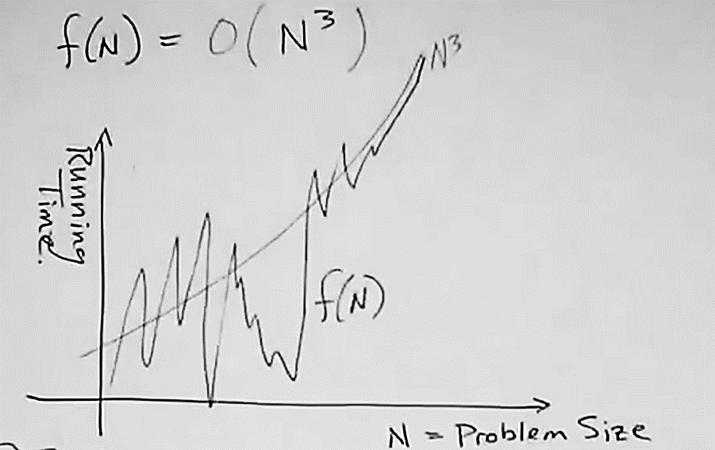

Slide 49
More Examples …
We say that n⁴ + 100n² + 10n + 50 is of the order of n⁴ or O(n⁴)
We say that 10n³ + 2n² is O(n³)
We say that n³ - n² is O(n³)
We say that 10 is O(1),
We say that 1273679 is O(1)
In general, an O(n²) algorithm will be slower than O(n) algorithm.
Warning: an O(n²) function will grow faster than an O(n) function

Slide 50
Eight Growth Functions
Eight functions O(n) that occur frequently in the analysis of algorithms (in order of increasing rate of growth relative to n):
Constant ≈ 1
Logarithmic ≈ log n
Linear ≈ n
Log Linear ≈ n log n
Quadratic ≈ n²
Cubic ≈ n³
Exponential ≈ 2^{n}
Exhaustive Search ≈ n!

Slide 51
Growth Rates Compared
 | n=1 | n=2 | n=4 | n=8 | n=16 | n=32
1 | 1 | 1 | 1 | 1 | 1 | 1
logn | 0 | 1 | 2 | 3 | 4 | 5
n | 1 | 2 | 4 | 8 | 16 | 32
nlogn | 0 | 2 | 8 | 24 | 64 | 160
n² | 1 | 4 | 16 | 64 | 256 | 1024
n³ | 1 | 8 | 64 | 512 | 4096 | 32768
2^{n} | 2 | 4 | 16 | 256 | 65536 | 4294967296
n! | 1 | 2 | 24 | 40320 | 20.9T | Don’t ask!

Slide 52
Ω(g), at least order g [Lower Bound]
Let f,g be any function R→R.
We say that “f is at least order g”, written Ω(g), if ∃c,k: f(x) ≥ cg(x), ∀x>k
“Beyond some point k, function f is at least a constant c times g (i.e., proportional to g).”
“f is at least order g”, or “f is Ω(g)”, or “f= Ω(g)” all just mean that f∈ Ω(g).

Slide 53
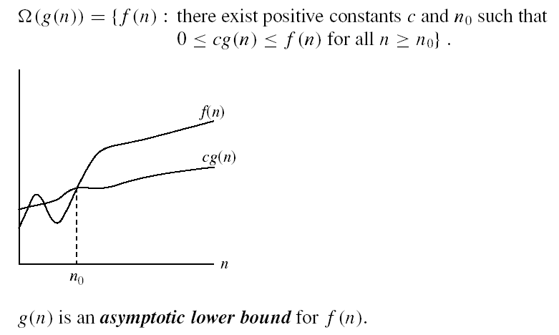
Big- Ω Visualization

Slide 54
Big- Θ
Definition: f(n) = Θ(g(n)) iff there exist positive constants c₁, c₂, and n₀ such that c₁g(n) ≤ f(n) ≤ c₂g(n) for all n, n ≥ n₀.
If a program P has complexities Θ(n) and program Q has complexities Θ(n²), then, in general, we can assume program P is faster than Q for a sufficient large n.

Slide 55
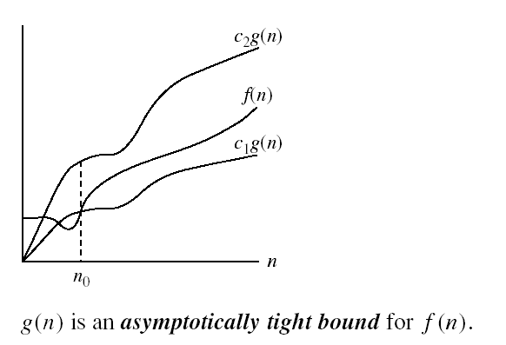
Big- Θ Visualization

Slide 56
Review of elementary Data Structures
Heaps
Hashing
Set Representation
UNION, FIND Operation

Slide 57
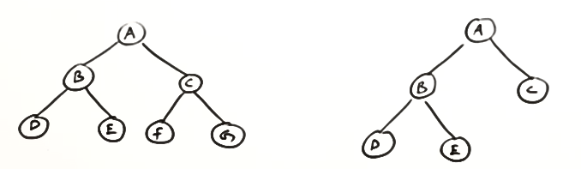
The Heap Data Structure
Heap is a data structure, which permits one to insert elements into a set and also to find the largest element efficiently
A heap is a complete binary tree
The height of a complete binary tree is logn

Slide 58
Heap Types
Max-heaps (largest element at root), have the max-heap property:
for all nodes i,
A[PARENT(i)] ≥ A[i]
Min-heaps (smallest element at root), have the min-heap property:
for all nodes i,
A[PARENT(i)] ≤ A[i]

Slide 59
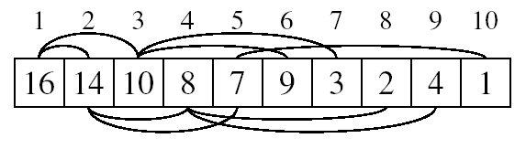
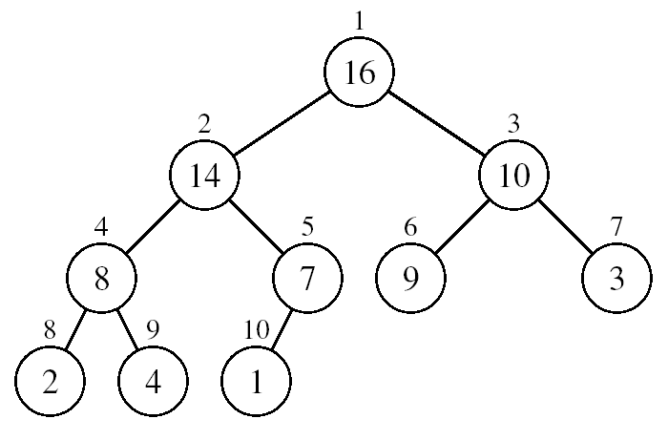
Array Representation of Heaps
A heap can be stored as an array A.
Root of tree is A[1]
Left child of A[i] = A[2i]
Right child of A[i] = A[2i + 1]
Parent of A[i] = A[ ⎣i/2⎦ ]
Creating a heap from the given array element is done in O(nlogn) time

Slide 60
Adding/Deleting Nodes
New nodes are always inserted at the bottom level (left to right)
Nodes are removed from the root then replace the node with the bottom element (right to left) then maintain the heap.
Deleting or inserting an element from a heap is done in O(logn) time

Slide 61
Operations on Heaps
Maintain/Restore the max-heap property
- MAX-HEAPIFY
Create a max-heap from an unordered array
- BUILD-MAX-HEAP
Sort an array in place
- HEAPSORT

Slide 62
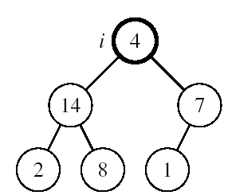
1. Maintaining the Heap Property (MAX-HEAPIFY)
Suppose a node is smaller than a child
Left and Right sub trees of i are max-heaps
To eliminate the violation:
Exchange with larger child
Move down the tree
Continue until node is not smaller than children

Slide 63
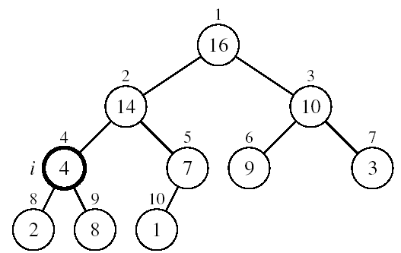
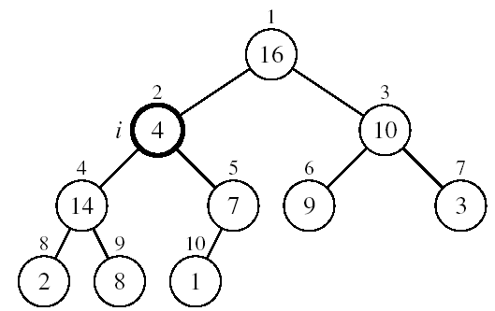
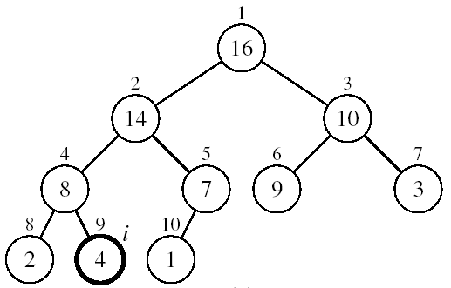
Example
MAX-HEAPIFY(A, 2, 10)
A[2] ↔ A[4]
A[2] violates the heap property
A[4] violates the heap property
A[4] ↔ A[9]
Heap property restored

Slide 64
Maintaining the Heap Property
Alg: MAX-HEAPIFY(A, i, n)
l ← LEFT(i)
r ← RIGHT(i)
if l ≤ n and A[l] > A[i]
then largest ←l
else largest ←i
if r ≤ n and A[r] > A[largest]
then largest ←r
if largest ≠ i
then exchange A[i] ↔ A[largest]
MAX-HEAPIFY(A, largest, n)
Assumptions:
Left and Right subtrees of i are max-heaps
A[i] may be smaller than its children

Slide 65
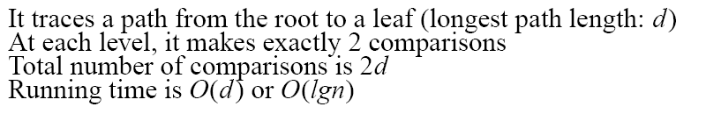
MAX-HEAPIFY Running Time
Intuitively:
Running time of MAX-HEAPIFY is O(logn)
Can be written in terms of the height of the heap, as being O(h)
Since the height of the heap is ⎣logn⎦
-
-
-
-

Slide 66
2. Building a Heap- BUILD-MAX-HEAP
Convert an array A[1 … n] into a max-heap (n = length[A])
The elements in the subarray A[(⎣n/2⎦+1) .. n] are leaves
Apply MAX-HEAPIFY on elements between 1 and ⎣n/2⎦
Alg: BUILD-MAX-HEAP(A)
n = length[A]
for i ← ⎣n/2⎦ downto 1
do MAX-HEAPIFY(A, i, n)
1
4
2
3
1
3
4
5
6
7
2
16
9
10
8
9
10
14
8
7
A:
4 | 1 | 3 | 2 | 16 | 9 | 10 | 14 | 8 | 7

Slide 67
Example: A
4 | 1 | 3 | 2 | 16 | 9 | 10 | 14 | 8 | 7
i = 5
i = 4
i = 3
1
1
1
4
4
4
2
3
2
3
2
3
1
3
1
3
1
3
4
5
6
7
4
5
6
7
4
5
6
7
2
16
9
10
2
16
9
10
14
16
9
10
8
9
10
8
9
10
8
9
10
14
8
7
14
8
7
2
8
7
i = 2
i = 1
1
1
1
4
4
16
2
3
2
3
2
3
1
10
16
10
14
10
4
5
6
7
4
5
6
7
4
5
6
7
14
16
9
3
14
7
9
3
8
7
9
3
8
9
10
8
9
10
8
9
10
2
8
7
2
8
1
2
4
1

Slide 68
Running Time of BUILD MAX HEAP
Alg: BUILD-MAX-HEAP(A)
n = length[A]
for i ← ⎣n/2⎦ downto 1
do MAX-HEAPIFY(A, i, n)
O(n)
O(logn)
⇒ Running time: O(nlogn)

Slide 69
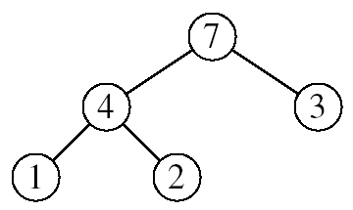
3. Heap Sort
A conceptually simple sorting strategy which continually removes the maximum value from the remaining unsorted elements.
Goal: Sort an array using heap representations
Idea:
Build a max-heap from the array
Swap the root (the maximum element) with the last element
in the array
“Discard” this last node by decreasing the heap size
Call MAX-HEAPIFY on the new root
Repeat this process until only one node remains

Slide 70
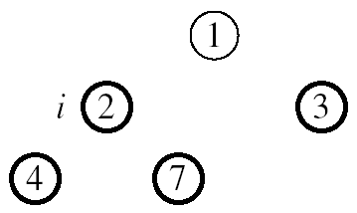
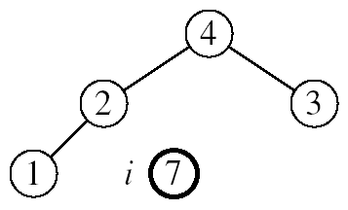
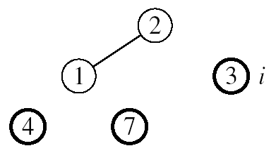

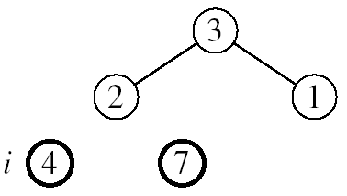
Example: A=[7, 4, 3, 1, 2]
MAX-HEAPIFY(A, 1, 4)
MAX-HEAPIFY(A, 1, 3)
MAX-HEAPIFY(A, 1, 2)
MAX-HEAPIFY(A, 1, 1)

Slide 71
Alg: HEAPSORT(A)
BUILD-MAX-HEAP(A)
for i ← length[A] downto 2
do exchange A[1] ↔ A[i]
MAX-HEAPIFY(A, 1, i - 1)
Running time: O(nlogn)
O(n)
n-1 times
O(logn)

Slide 72
Set Representation
Trees can be used to represent sets.
A set is a collection of objects.
Set A is a subset of set B if all elements of A are in B.
Subsets are sets
Union of two sets A and B is a set C which consists of all elements in A and B
Two sets are mutually disjoint if they do not have a common element.

Slide 73
Union and Find operations
Disjoint set Union
Need to form union of two different sets of a partition
If S_{i} and S_{j} are two disjoint sets, then their union S_{i} ∪S_{j} = {all elements x such that x is in S_{i} or S_{j}}.
Find (i)
Find the set containing element i.
Need to find out which set an element belongs to

Slide 74
Possible Tree Representation of Sets
Set 2 = {4 , 1 ,9}
S₁
S₂
S₃
0
4
2
6
7
8
1
9
3
5
Set I = {0 , 6 ,7 ,8 }
Set 3 = {2 , 3 , 5}

Slide 75
Unions of Sets
To obtain the union of two sets, just set the parent field of one of the roots to the other root.
To figure out which set an element is belonged to, just follow its parent link to the root and then follow the pointer in the root to the set name.
It is useful to identify the existence of a cycle in the graph.

Slide 76
Possible Representations of S₁ ∪S₂
S₁
S₂
0
4
S₂
6
7
8
4
1
9
1
9

Slide 77
Possible Representations of S₁ ∪S₂
S₁
S₂
0
4
S₁
6
7
8
0
1
9
6
7
8

Slide 78
Hashing
A symbol table is a data structure which allows one to easily determine the presence or absence of an arbitrary element.
Hashing is the most practical technique for maintaining a symbol table.
The implementation of hash tables is called hashing.
Hashing is a technique used for performing insertions, deletions and finds in constant average time (i.e. O(1))
This data structure, however, is not efficient in operations that require any ordering information among the elements, such as findMin, findMax and printing the entire table in sorted order.

Slide 79
Example
Hash
Table
0
1
Items
Hash
Function
2
john 25000
3
john 25000
phil 31250
key
4
phil 31250
dave 27500
5
mary 28200
6
dave 27500
7
mary 28200
key
8
9

Slide 80
Operations
Initialization: all entries are set to NULL
Find:
locate the cell using hash function.
sequential search on the linked list in that cell.
Insertion:
Locate the cell using hash function.
(If the item does not exist) insert it as the first item in the list.
Deletion:
Locate the cell using hash function.
Delete the item from the linked list.

Slide 81
Do you see any problems with this approach?
0
U
(universe of keys)
h(k₁)
h(k₄)
k₁
K
(actual
keys)
k₄
k₂
h(k₂) = h(k₅)
Collisions!
k₅
k₃
h(k₃)
m - 1
Two or more keys hash to the same slot!!
Avoiding collisions completely is hard,
even with a good hash function
If there are too many collisions, performance of the hash table will suffer dramatically.

Slide 82
Review literature on the following topics
Array vs. linked list data structure: Overview, pros & cons, types of arrays/linked list, algorithm for basic operations, analyze their complexity
Stack vs. Queue data structures: Overview, pros & cons, types of stack/queue: algorithm for basic operations, analyze their complexity
Tree data structures: Overview, unbalanced & balanced tree, tree traversal, algorithm for basic operations, analyze their complexity
Sorting algorithms (include advanced algorithms in your discussion): Overview, discuss sorting algorithm, show bubble & quick algorithm, analyze their complexity
Searching algorithms (include advanced algorithms in your discussion): Overview, discuss searching algorithms, show linear & binary algorithms, analyze their complexity

Slide 83
THE END

